Slide 1


Slide 2
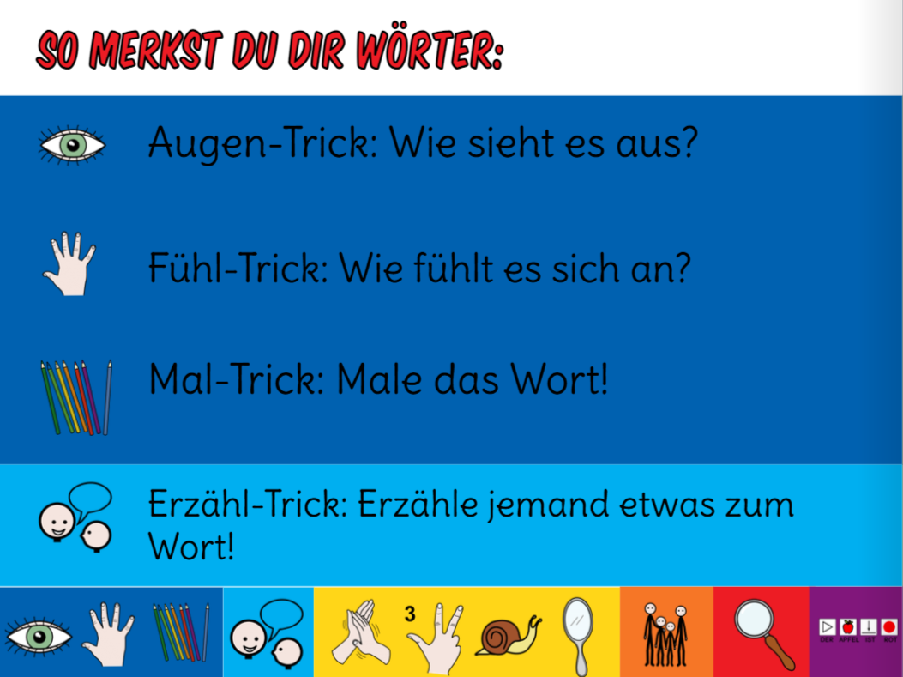

Slide 3


Slide 4
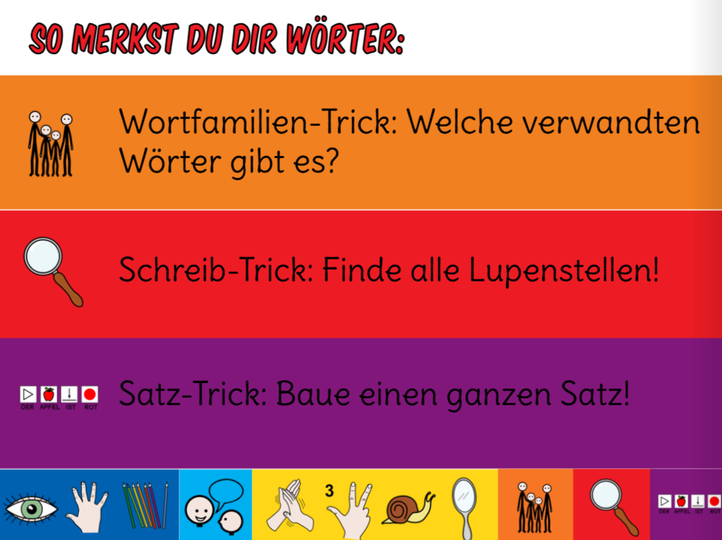

Slide 5


Slide 6
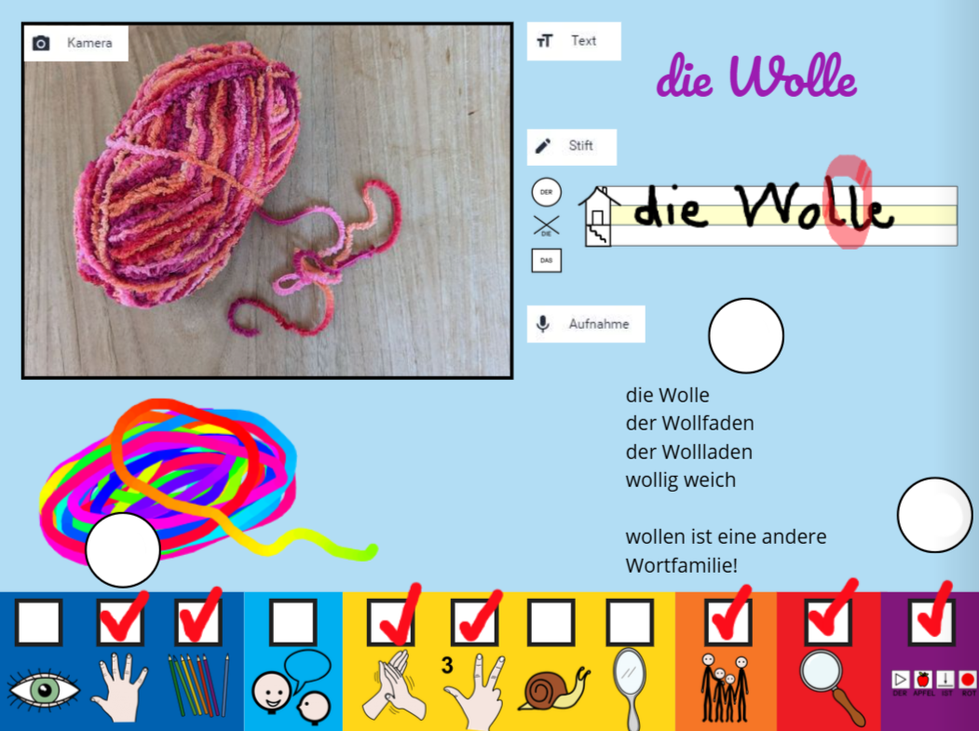


Slide 7
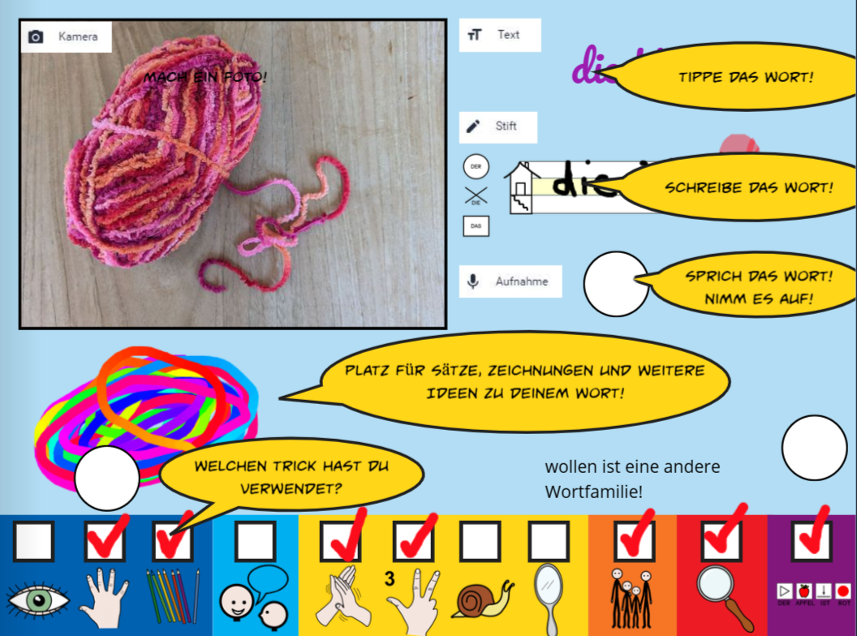

Slide 8
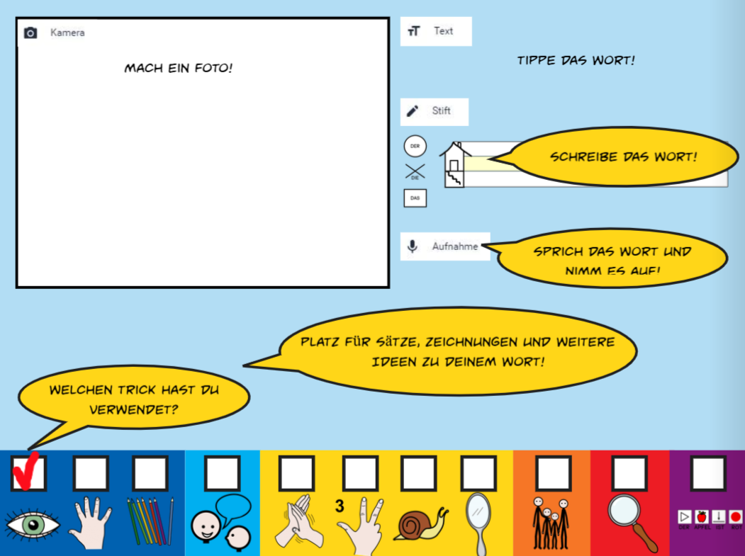

Slide 9


Slide 10
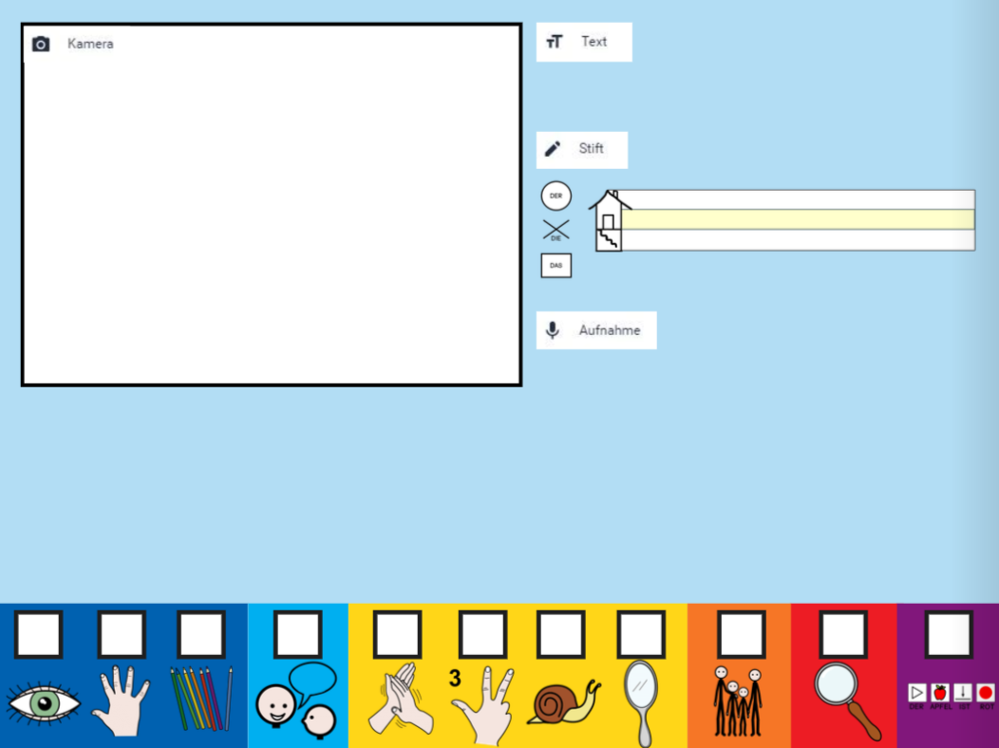

Slide 11
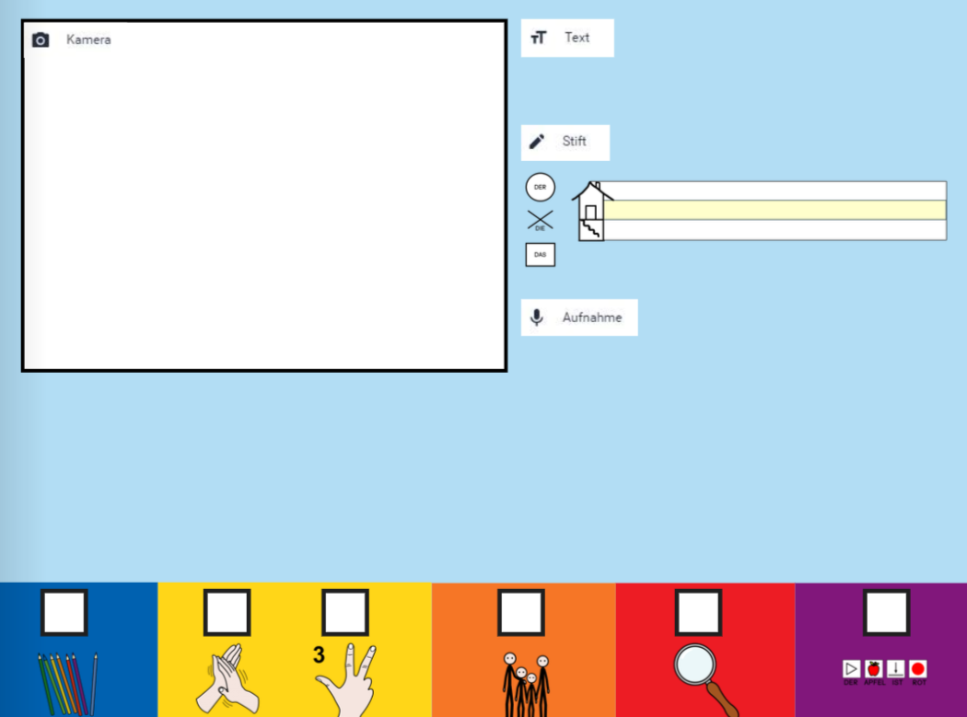

Slide 12
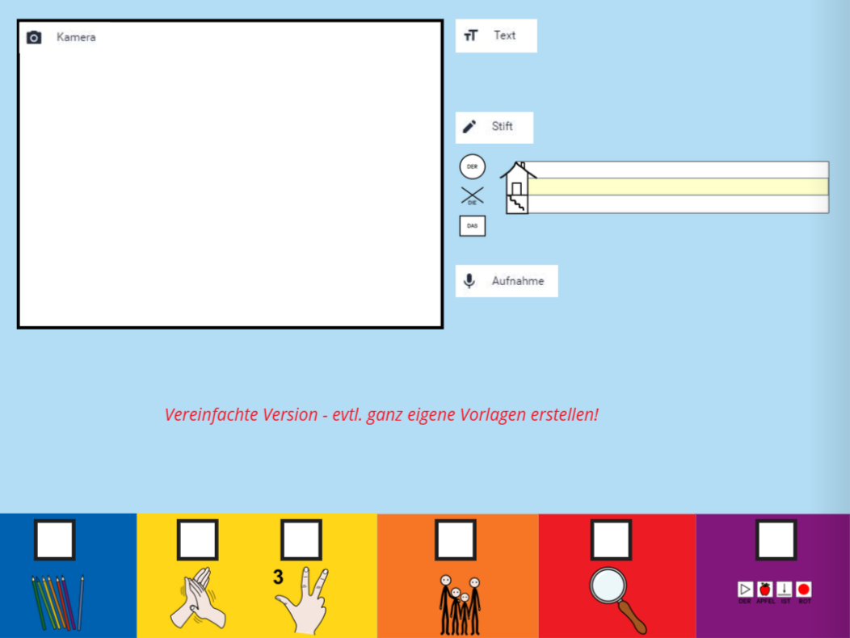

Slide 13


Slide 14


Online lesbare Version: https://read.bookcreator.com/TCI87fw1CbO6mzEXowuIMySyJxU2/I43Kn5z9T3G7NDW9Dp3m3A

